Slide 1
Redux (State Management)
Salman Ahmed G

Slide 2
What is flux
Flux is a Javascript architecture or pattern for UI which runs on a unidirectional data flow and has a centralized dispatcher.
It is useful when your project has dynamic data and you need to keep the data updated in an effective manner.
It was created by Facebook, and complements React as view. This model is used to ease maintenance.
It has three primary components: Views, Stores, and Dispatcher.
As the MVC application grows, we find many numbers of views as models, which are all talking to each other, making it difficult to manage and debug.

Slide 3
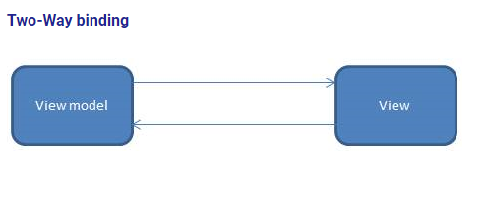
Two way data binding

Slide 4
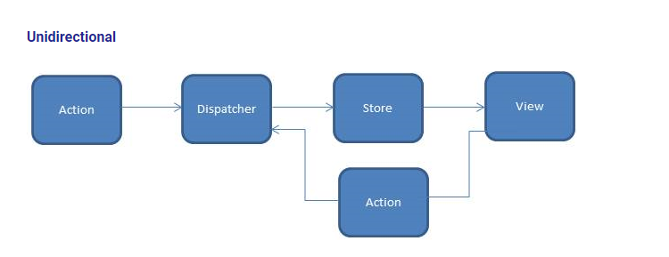
Unidirectional flow

Slide 5
Flux properties
Action: Action describes user interaction that occurred in a component, such as a user clicking a button. Dispatcher: Dispatcher methods are invoked by an action component. This emits an event with data that needs to go to a store, which is a singleton registry. Store: The store listens to certain events from the dispatcher. When it listens to an event from the dispatcher, it will then modify its internal data and emit a different event for views. View: Views are typically a react component. Views get data from the store and set up a listener to refresh itself when the store emits any changed events.

Slide 6
What is redux
Redux is an open-source JavaScript library for managing and centralizing application state. It is most commonly used with libraries such as React or Angular for building user interfaces. Similar to (and inspired by) Facebook's Flux architecture, it was created by Dan Abramov and Andrew Clark.

Slide 7
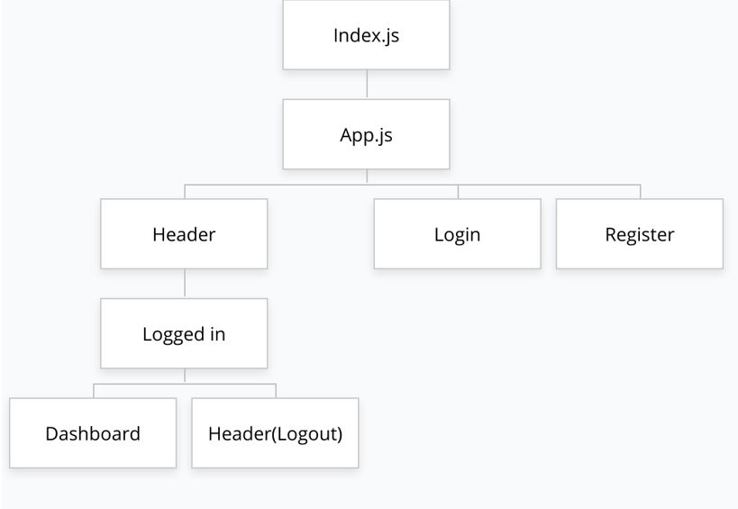
Scenario - 1

Slide 8
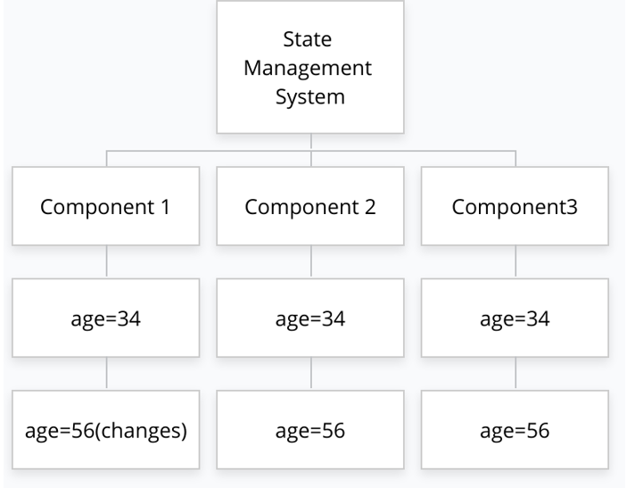
Scenario -2

Slide 9
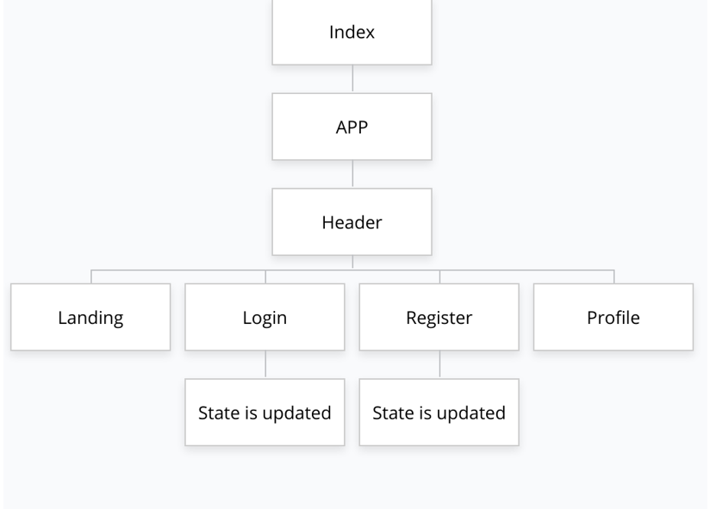
Redux comes to help

Slide 10
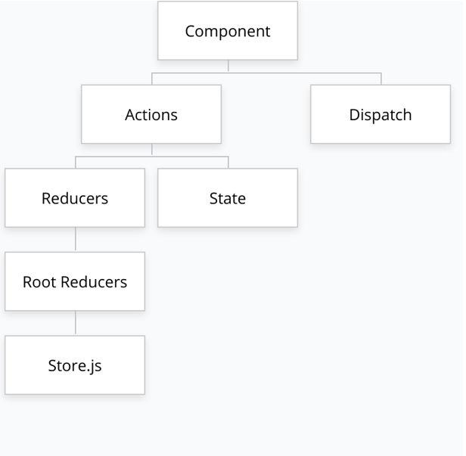
Redux flow

Slide 11
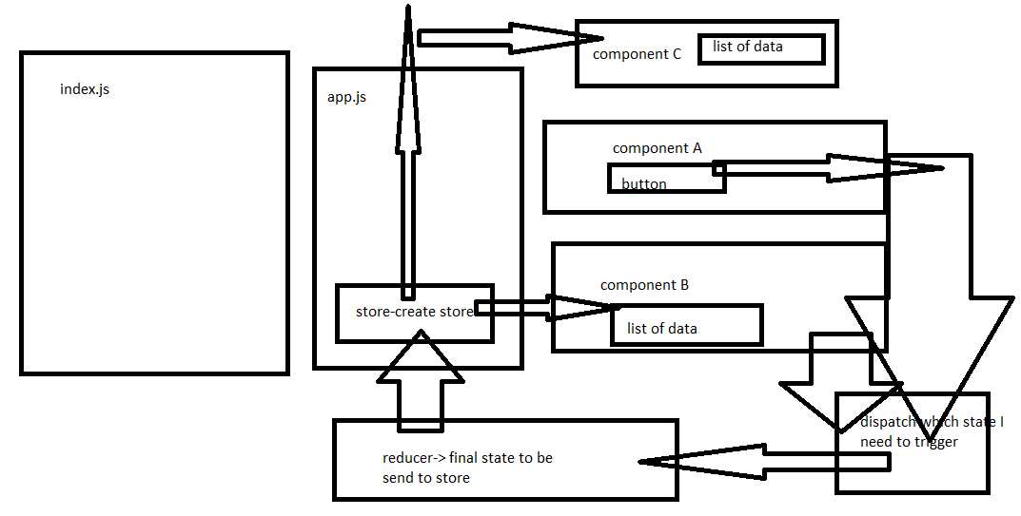

Slide 12
Redux package
Install the following package:
1.npm install redux
2.npm install react-redux

Slide 13
Steps
1.Create the store
2.Create the root reducers
3.Create the state reducers
4.Dispatch
5.Access the state

